Slide 1
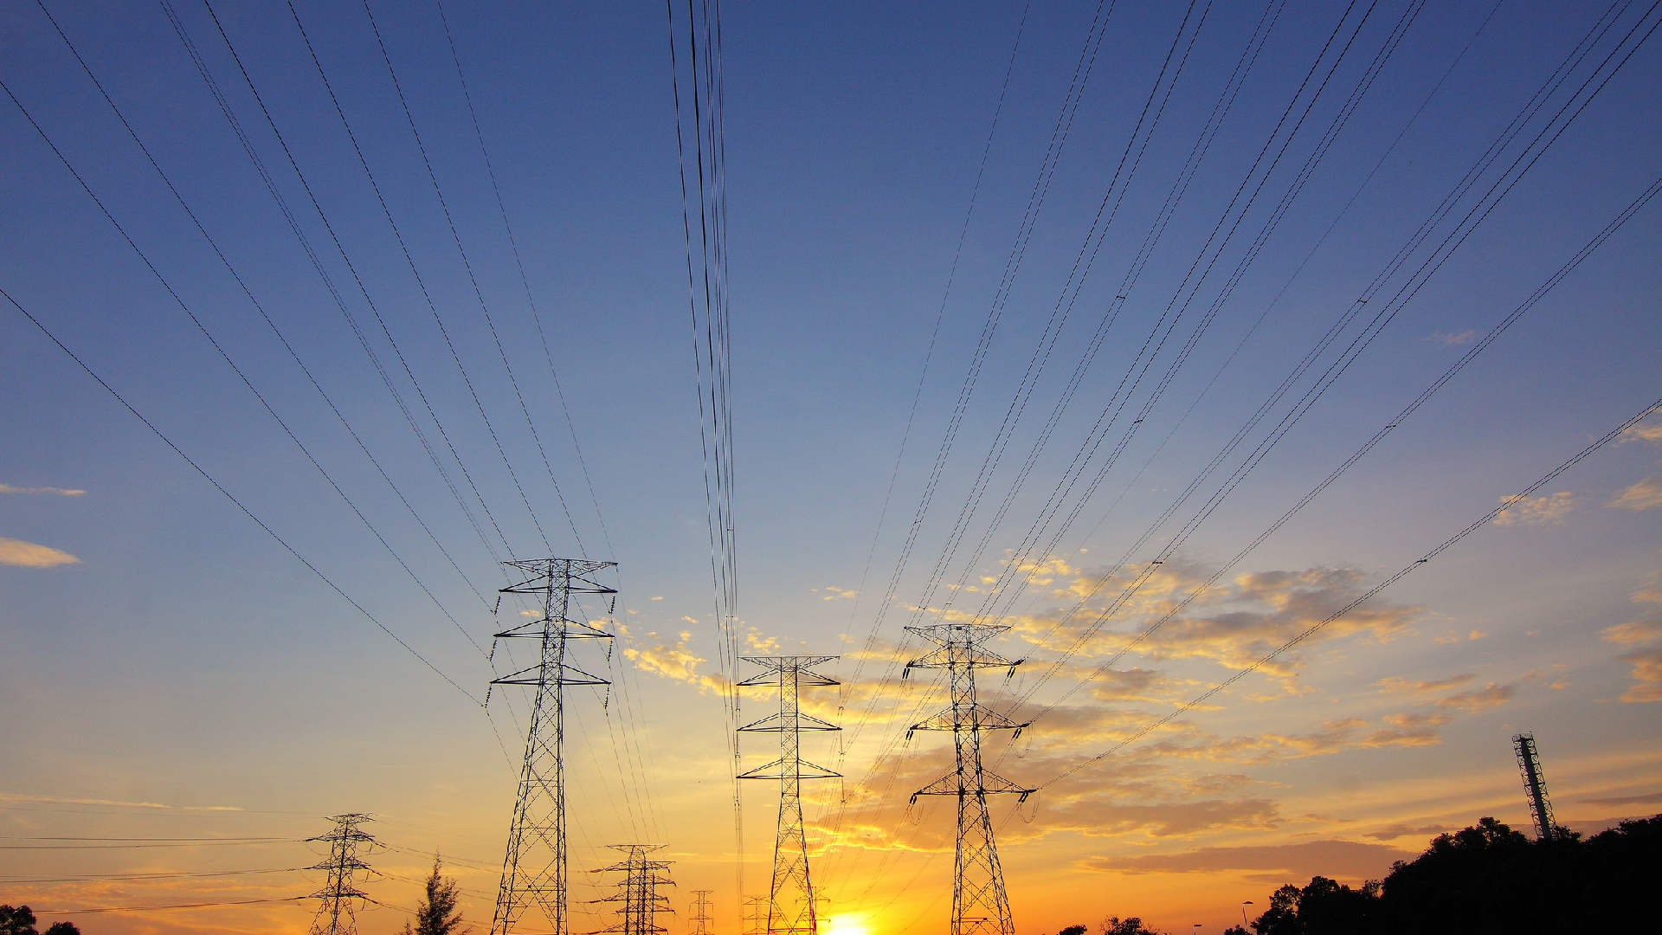


Sustainablity
(Demand shaping:
Build Carbon aware application)

Slide 2
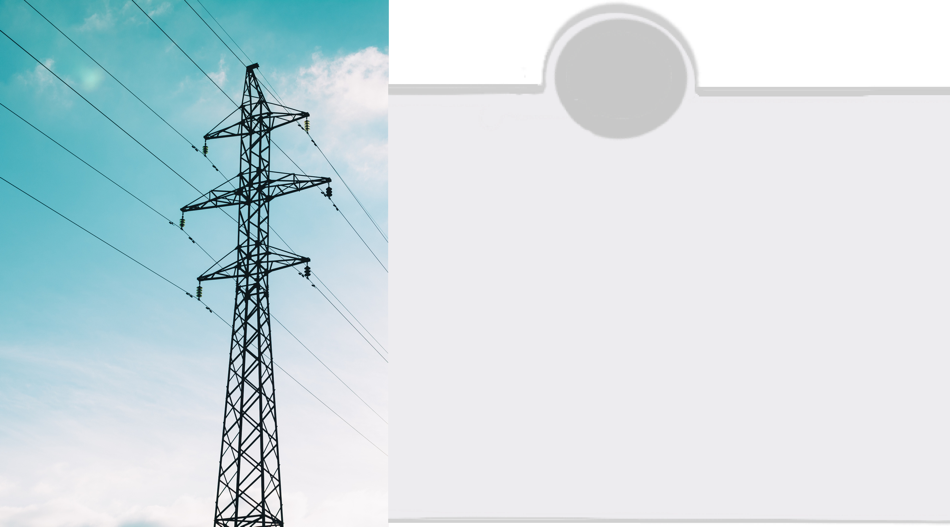

Building an web application to create a interest on energy saving among people
The application is like a scoring streak on daily activity basis in order to contribute for energy saving.
The application is also used to share people’s eco activities as stories
The main moto of this application is to create a individual person’s interest on energy saving
Idea Approach:

Slide 3
Objective:
Basically it is a carbon aware software(web application) used to create awareness about energy consumption and carbon awareness.
It creates awareness by taking the photos of the digital multimeter at users home.
First users should login the web by using email id
Then the users should give the details of the electronic gadgets used in their homes.
The usage of energy will be noted regularly
At the end of the month based on who contains more streaks based on saving the will be displayed in the toper board of the website and they will be rewarded.

Slide 4
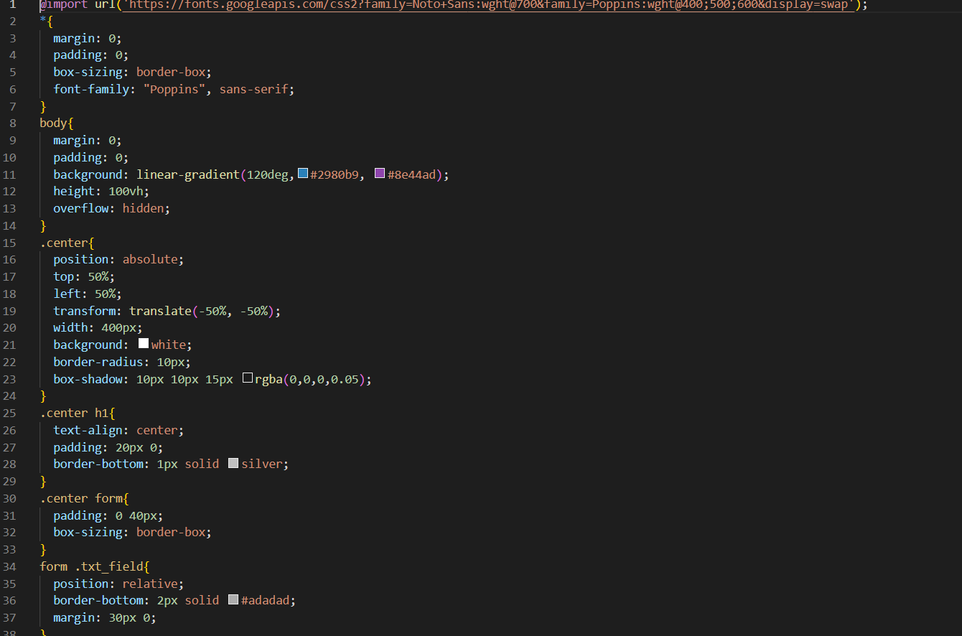
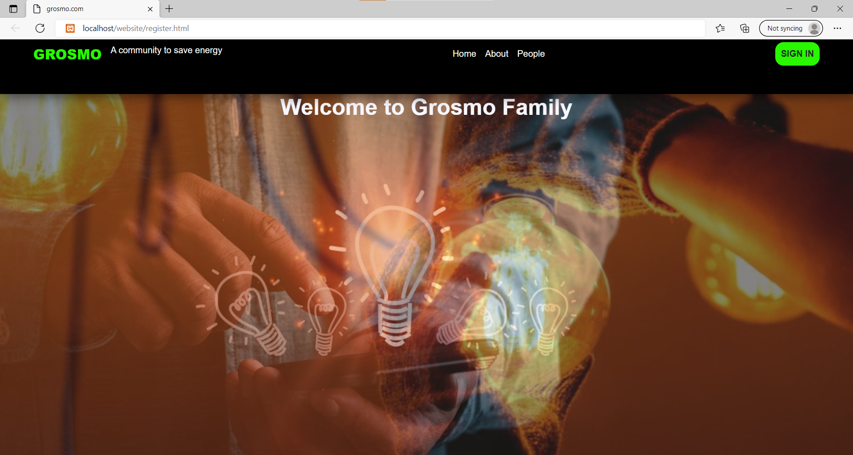
In order to find the solution within two days, we chose to develop web application instead of mobile application.
First we created home page using html, css
Problem approach:

Slide 5
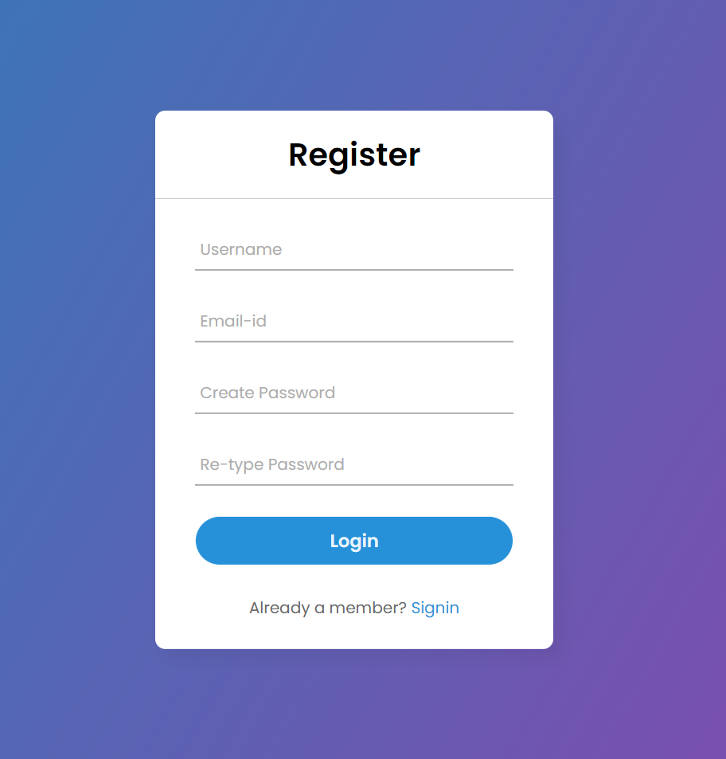
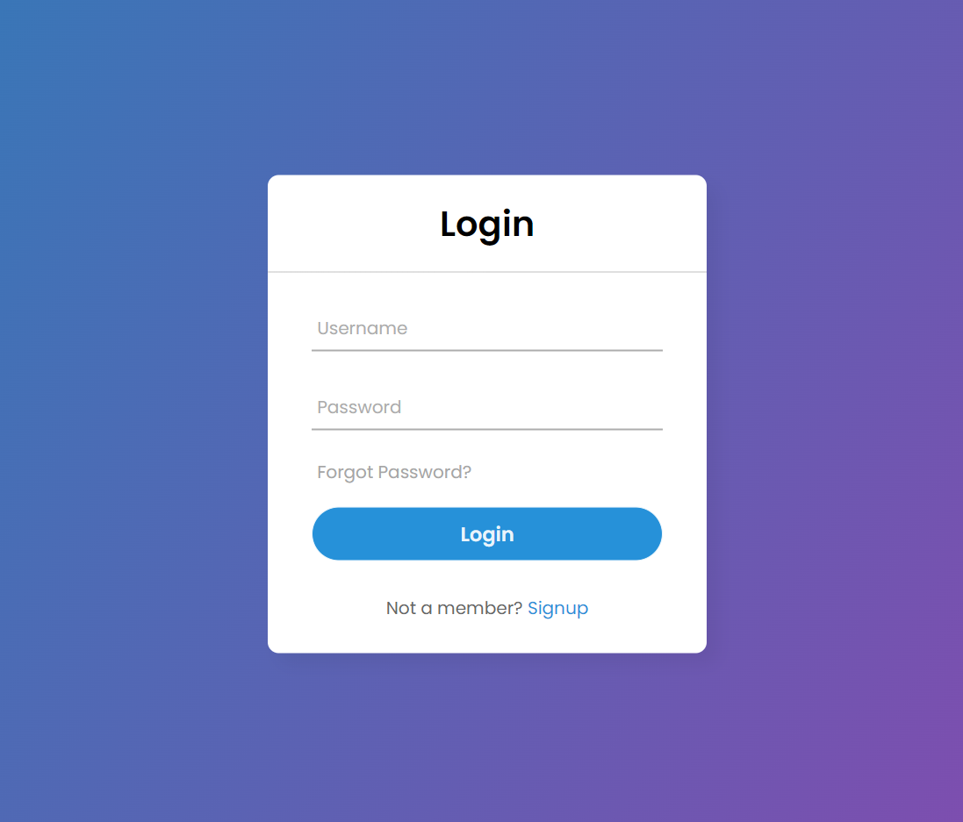
Next we created user sign in and sign up pages

Slide 6
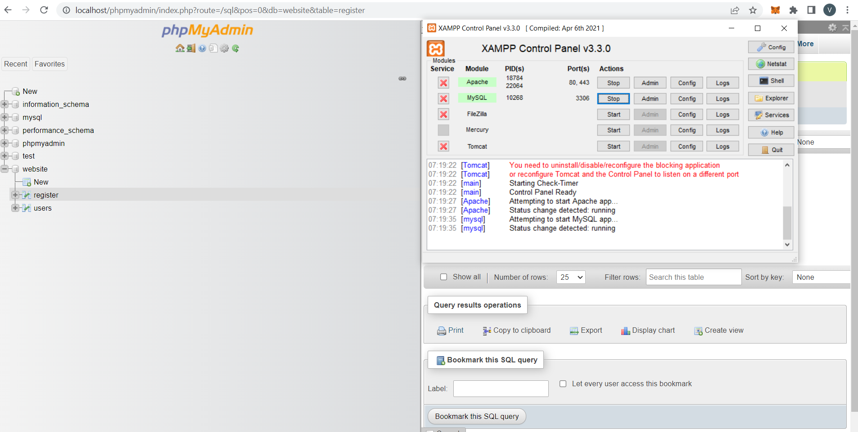
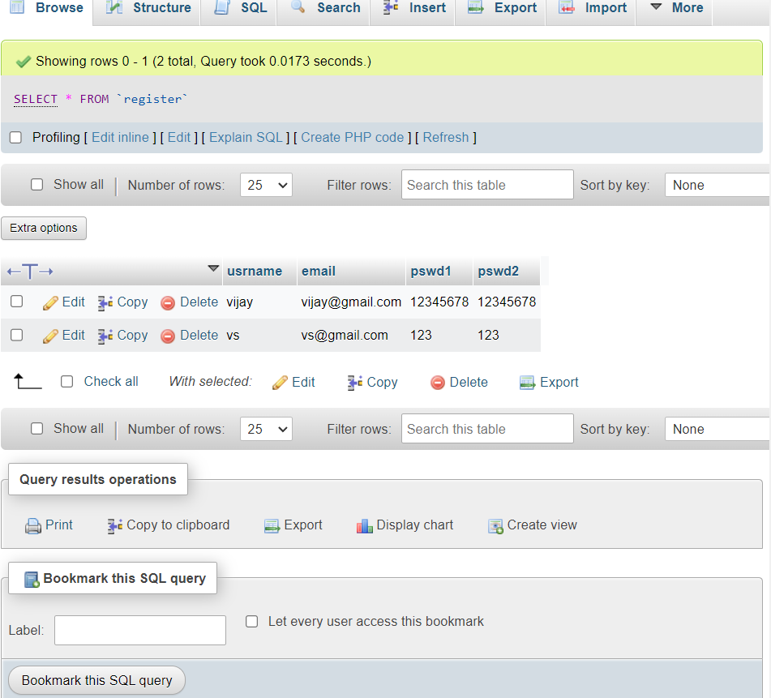
To save user data for login and other purpose we created a local server using XAMPP. We saved the datas at My SQL database.

Slide 7
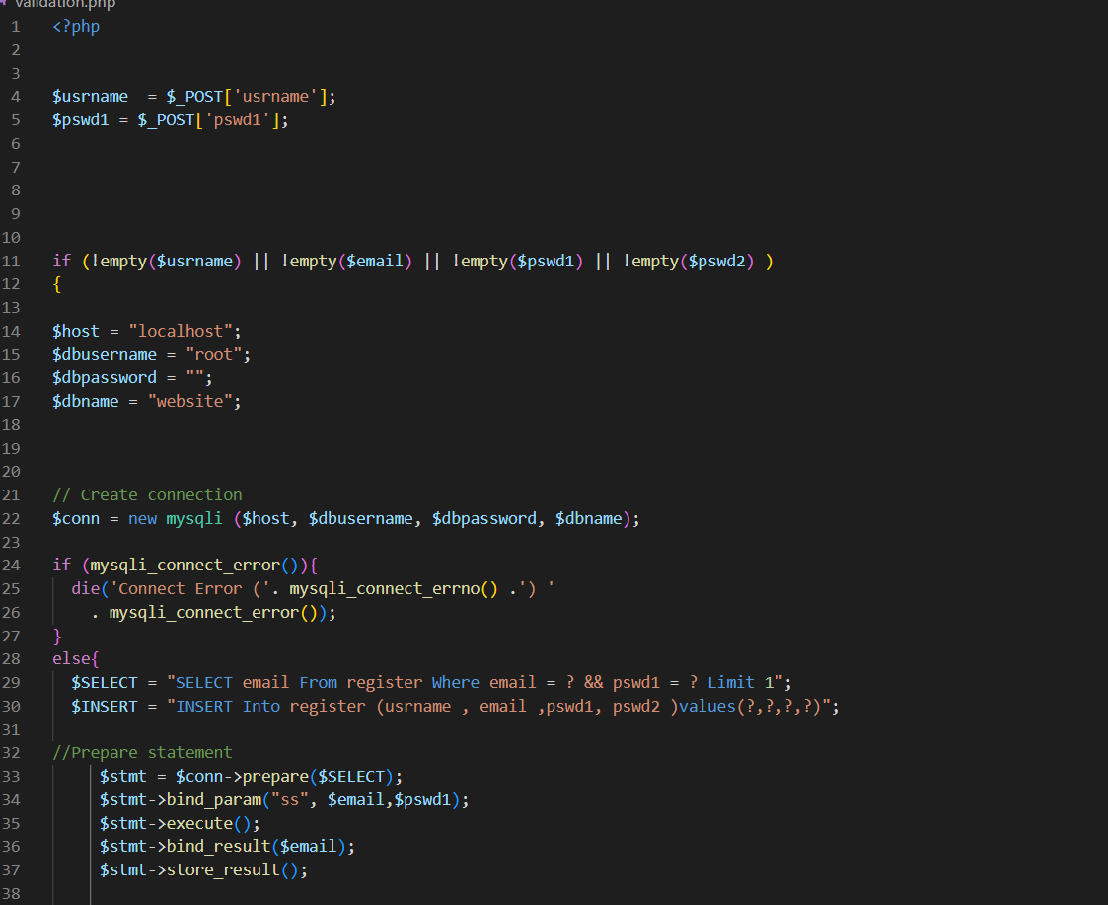
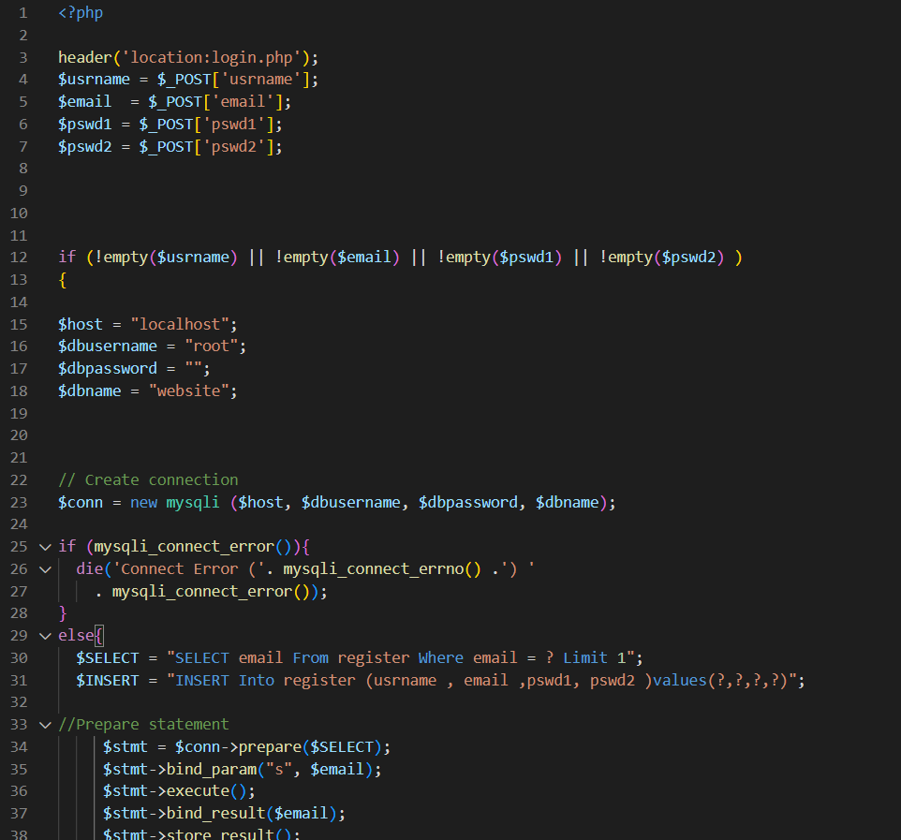
Next we used PHP to connect database with our frontend

Slide 8
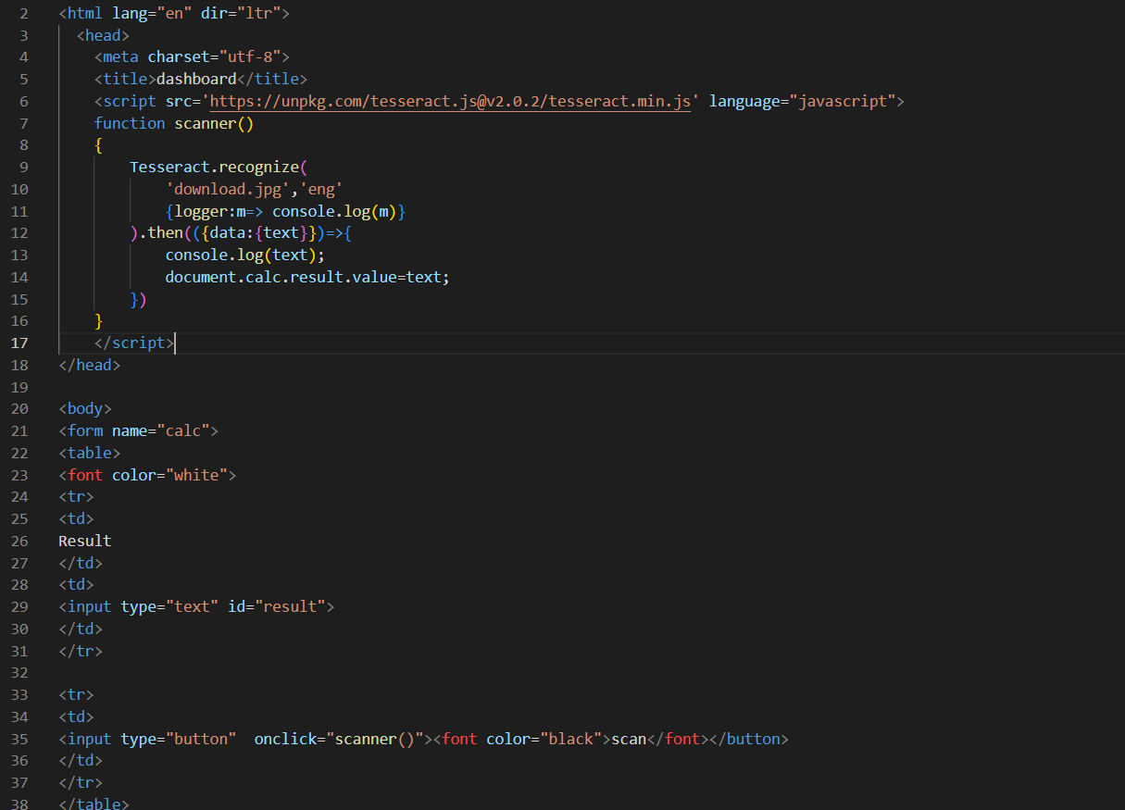
To get electricity detail from the user we used Tesseract.js
to extract text from image.

Slide 9
Further to be done :
As a prototype within limited time we had done only demo website.
We had further idea to find the carbon emission is based on their electricity usage.
And decided to provide coupen codes and rewards for to reducing their percentage of their electricity usage day by day.

Slide 10


Proposed Technological Solution:
The energy consumption awareness will created among people.
We use html and css for frontend ,database is used and php is used to connect database and for backend javascript is used.
This will make people psychologically to consume less power

Slide 11

Conclusion:
Thus it is very helpful to create awareness among people about both energy saving and carbon awareness.

Slide 12


By
The Gladiators
Yuvaraj S
Nitish Kumar R
Vijay Sankar R
Alwin shyam F
Hari K S

